Slide 1
Linear regression (OLS)
Aslan Zorlu
GPIO-UvA

Slide 2
A look back on first experiences
Start up problems
Stata
Loading data
Please let me know ASAP if you still have problems
stata-commans for
All my exercises in the first video
Exercise 1
already on Canvas

Slide 3
This video
Link between RQ and data
OLS regression technique
Treatment of continue and factor variables
Reference category in factor variables
Dealing with outliers
Interpretation of results
Estimating strategy
Presentation of results
First assignment

Slide 4
Research Question?
Related to dependent (outcome) variable (Y)
For this lecture
RQ: To what extent is the value of houses determined by the size of house, …?

Slide 5
Why linear regression?
If dependent variable (Y) is a continues variable
A dichotomic (dummy) variable may be also considered continues (called Linear probability model)
Independent variables (Xs) may be any type

Slide 6
When a regression analysis needed?
In case of multiple explanatory variables (Xs)
In a multiple regression model, a variable has two functions:
measuring effect of this variable
controlling for this characteristic
To control (or holding constant) for some characteristics

Slide 7
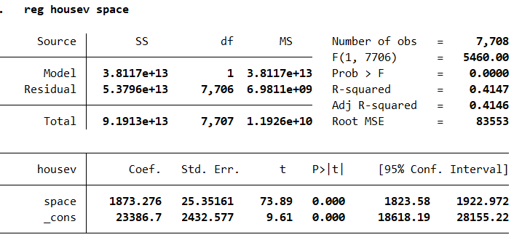


Simple OLS
To what extent is value of houses determined by the size of house?
Value of houses space
Regression function: $housev =α+βSpace$
Interpretation $β$: a 1 m² increase of space leads to $1873$ Euro higher price of an average house.
Space explains 41% of variance in price of houses.

Slide 8
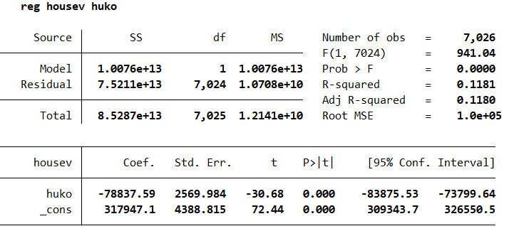
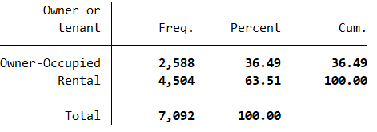
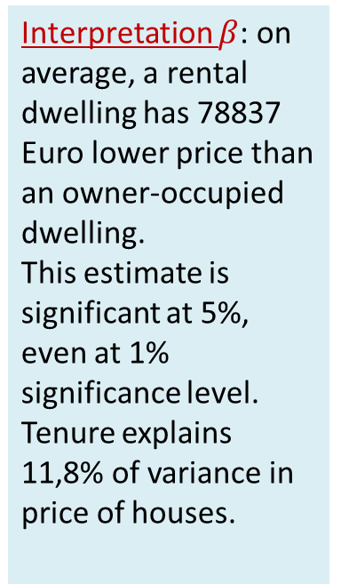
Simple OLS with a binary variable
To what extent is value of houses determined by the tenure of house?
Value of houses tenure
Interpretation $β$: on average, a rental dwelling has 78837 Euro lower price than an owner-occupied dwelling.
This estimate is significant at 5%, even at 1% significance level.
Tenure explains 11,8% of variance in price of houses.

Slide 9
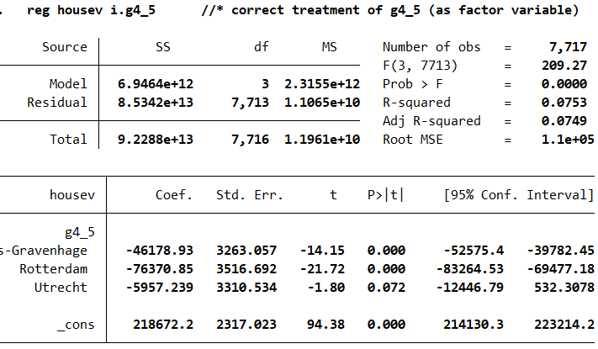
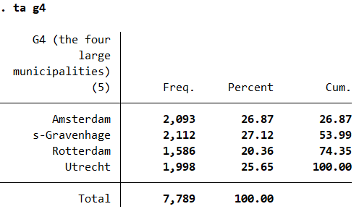

Simple OLS with a categorical (factor) variable
Is the price of houses different between the four large cities ?
Interpretation $β$: on average, a dwelling in the Hague has 46178 Euro lower price than dwelling in Amsterdam. A dwelling in Rotterdam has 76370 Euro lower price than dwelling in Amsterdam.
These estimates are significant at 5%, even at 1% significance level.
The price difference of €5957 between Utrecht and Amsterdam is not significant at 5% but significant at 10%.
Location explains 7,5% of variance in price of houses.

Slide 10
Interpretation procedure of a regression output
Check N
Correct use of X-variables
How Xs are measured? Metric, continue or factor
Reference categories of factor Xs?
Explained variance (R-sq): as expected?
Coefficients significant at 5%?
Interpretation of coefficients!

Slide 11
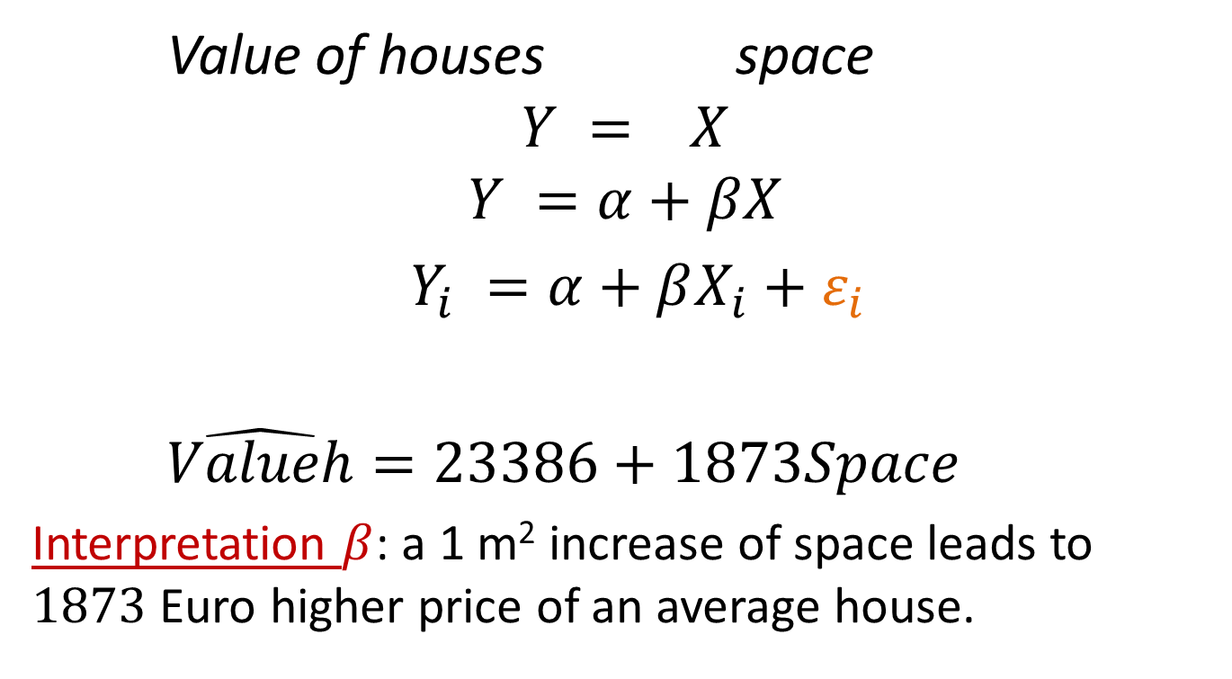
Explaining Y
Value of houses space
$$Y = X$$
$$Y =α+βX$$
$Y_{i} =α+βX_{i}+ε_{i}$
$\hat{Valueh}=23386+1873Space$
Interpretation $β$: a 1 m² increase of space leads to $1873$ Euro higher price of an average house.

Slide 12
Potential problems to check
Outliers can bias parameter estimates, in particular when N is small
Solution: drop outlier(s)
When the distribution of continues variables deviates strongly from a normal distribution: skewness < -2 or skewness>2
Solution: take logarithme

Slide 13
How to present descriptive results?
Example: Table 1. Descriptive Statistics
 | Mean | Std. D. | Min | Max | N
Price of dwelling (1000 euros) | 245.81 | 130.88 | 10 | 1000 | 69041
Size in sq-meters | 115.49 | 64.17 | 8 | 497 | 59893
 | % |  | min | max | N
Housing tenure |  |  |  |  | 60365
Rental | 38.68 |  | 0 | 1
Owner-occupied | 61.32 |  | 0 | 1
Construction period |  |  |  |  | 60211
to 1945 | 18.60 |  | 0 | 1
1946 to 1959, | 9.93 |  | 0 | 1
1960 to 1970, | 19.09 |  | 0 | 1
1971 to 1980, | 16.42 |  | 0 | 1
1981 to 1990, | 12.40 |  | 0 | 1
1991 to 2000 | 12.23 |  | 0 | 1
2001 or later | 11.33 |  | 0 | 1

Slide 14
How to present OLS results?
Example:
Table 2. OLS estimates of house value
 | model1 | model2 | model3
Size in sq-meters | 1008.4*** | 804.8*** | 785.0***
Rental (Reference)
Owner-occupied |  | -65374.9*** | -60062.3***
Up to 1945 (reference)
1946 to 1959 |  |  | -34169.8***
1960 to 1970 |  |  | -42313.8***
1971 to 1980 |  |  | -40176.5***
1981 to 1990 |  |  | -29574.1***
1991 to 2000 |  |  | -1803.5
2001 or later |  |  | 8633.6***
Constant | 124334.3*** | 173119.9*** | 194390.1***
N | 59664 | 59542 | 59542
R² | 0.25 | 0.30 | 0.32
* p<.05; ** p<.01; *** p<.001

Slide 15
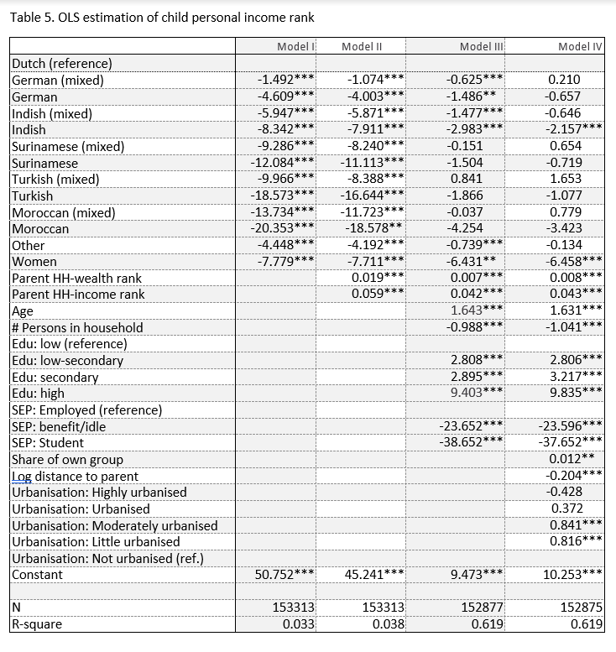
What to present and how?

Slide 16

Assignment 1. OLS regression
Variables are given

